Slide 1
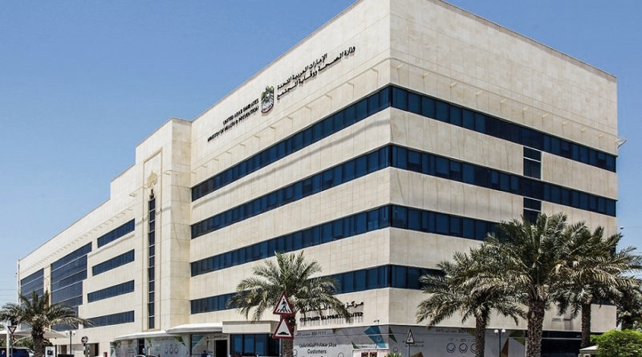
Updates from Ministry of Health & Prevention MOHAP
Ms. Al Anoud Salman, IAIOP
Quality & Excellence Manager,
Acting Assistant Director

Slide 2
The Journey….
Station1
UAE Vision 2021
Station 2
MOHAP
Strategy
Station 3
Innovation Strategy
Station 4
Achievements & KPIs
Station 5
Photo Gallery
Station 6
Re-capping

Slide 3
08 Nov 2018
We want to be among the
Best countries in the world by
2021

Slide 4
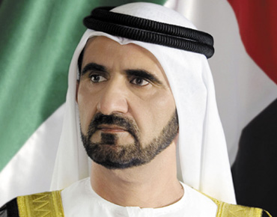
“Creating sustainable wealth for future generations will depend on science, knowledge, technology and innovation.”
“ We want our public and private sectors to explore new horizons to develop our economy. Innovation is our only way to build a great history of the UAE”

Slide 6
Station 2: MOHAP Strategy 2017-2021
Vision: An effective and sustainable healthcare system for a happy society
Mission: To enhance community health by providing comprehensive, innovative, and fair healthcare services as per international standards, and performing its role as a regulator and supervisor of the healthcare sector through a modern and integrated health legislative system
Values
Patient Priority
Excellence &
leadership
Initiative and
productivity
Accountability
Respect
Innovation
Teamwork
Community Happiness

Slide 7
Station 2: Cont.,
MOHAP Strategic Objectives 2017-2021
Provide a comprehensive and integrated healthcare in innovative and sustainable manner to prevent the spread of diseases in the community.
Develop effective health information systems and apply global standards in the management of health facilities and infrastructure.
Build quality and safety for therapeutic, healthcare and pharmaceutical systems according to international standards.
Provide a vital legislative framework and, governance, and distinctive regulatory and supervisory services for the healthcare sector
Ensure and guarantee the provision of all administrative services according to the standards of quality, efficiency and transparency.
Building culture of innovation in the work environment

Slide 8
Station 3: Innovation Strategy
?
So….
From where we got our Innovation Strategy

Slide 9
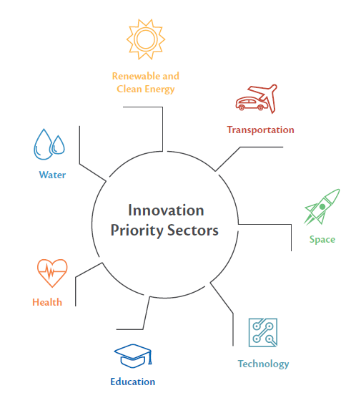
The NIS aims to promote innovation in the delivery of health and therapeutic services using advanced technologies such as robotic surgery and telemedicine techniques

Slide 10
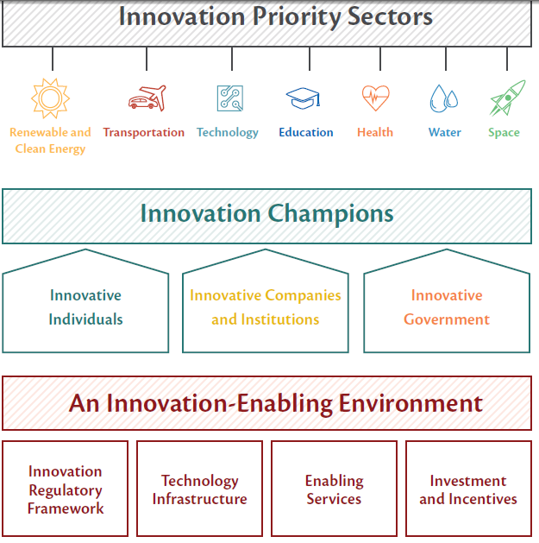
NIS
Framework

Slide 11
MOHAP Innovation Strategy
MOHAP Innovation Strategy
6th Strategic Objective
«”Enhance the culture of Innovation at the Work Environment»
National Innovation Strategy
Innovation Operational Plan :Initiatives, activities and programs

Slide 12
The main initiatives
01
02
03
04
Knowledge Management for Innovation
Developing new systems for managing innovation
Enhancement and capacity building in innovation
Innovation in improving processes and services

Slide 13
The Road Map
Creating Innovative Culture
Supporting Innovative Ideas
Assessing & Funding projects
Initiating innovative projects
Creating network of external/internal stakeholders
Intellectual property

Slide 14
Global Accreditation
Specialized training in innovation
Innovation Partners
Benchmarking
Innovative projects
Specialized studies and research

Slide 15
Station 4: Achievements & KPIs
Inventions
Innovation Pioneers
Intellectual properties registered
Employees have innovation diploma
8771 Ideas from MOHAP Staff 2015 -2017
Inventions Events
International & local awards
Memberships with institutions specialized in innovation
Employees Rewarded
1901 Employees trained in innovation

Slide 16
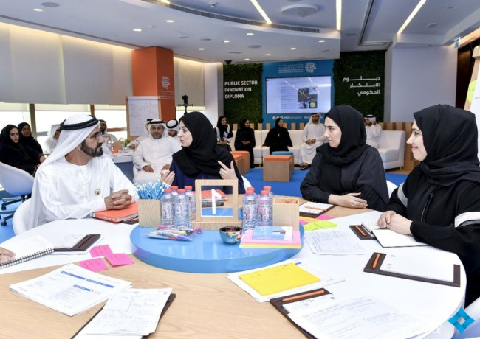
Public Sector Innovation Diploma

Slide 18
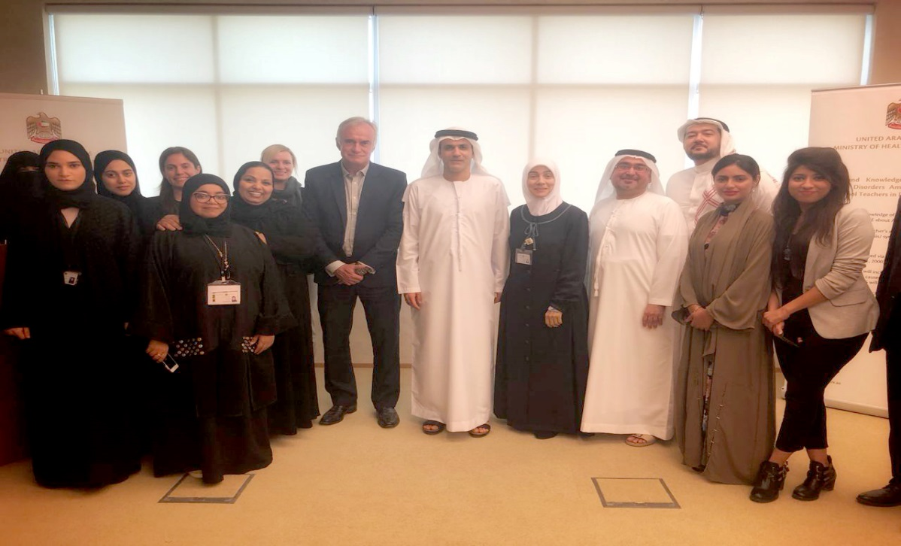
ADHD Project Launch 2018

Slide 19
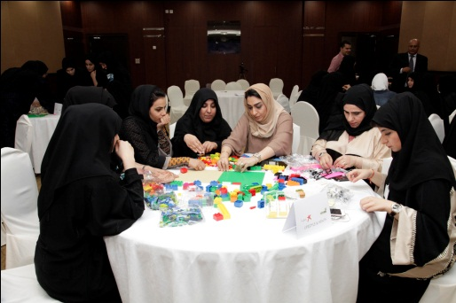
Innovation Workshops

Slide 20
Innovative Platforms
2017
2018
A platform for managing ideas and innovation with advanced features
Quick & easy to access 24/7
Transparent Evaluation
SME’s involvement
Advanced Dashboards & reporting system
Ideas crowd sourcing feature
Platinum accreditation from (IDEAS UK)

Slide 21
Innovative Platforms
Maharati, an open source Moodle learning management system,
Will be used to deliver training to medical and administrative personnel from the Ministry.
Developed by the MOHAP Training and Development Center TDC in Sharjah. Helping continuous skills improvement for the medical and administrative staff
Using internationally accredited sources of training and knowledge; and enhance the attractiveness of the health professions in line with the Ministry's strategies.
The project Showcased in GITEX 2018
Let Us watch the

Slide 22
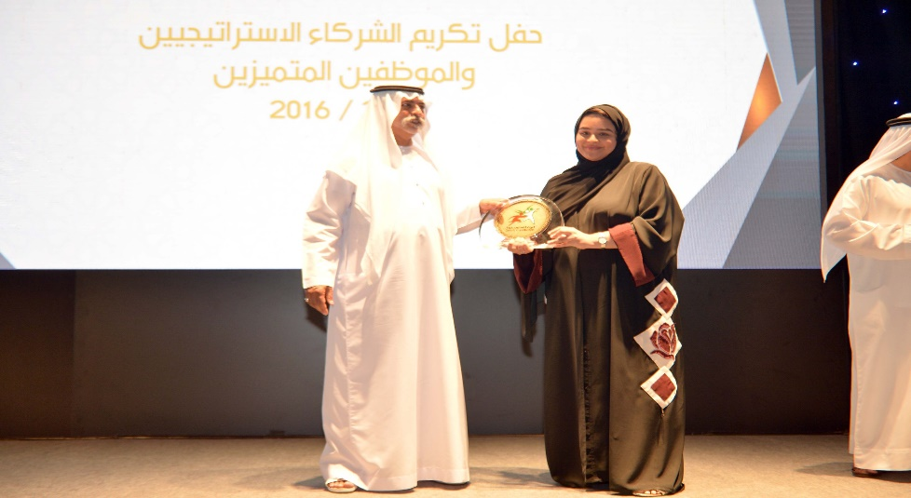
Successful Stories….
2016: Winning the Infosil International Award / Best Interactive Performance Indicators Panel / 2016
2017: Ministry of Health & Prevention wins first place for its Heroes of Health smart application

Slide 23
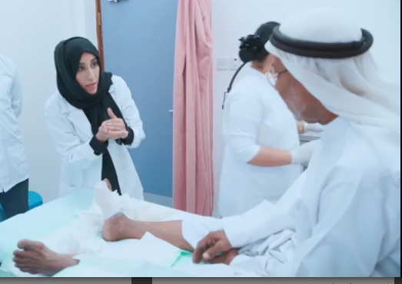
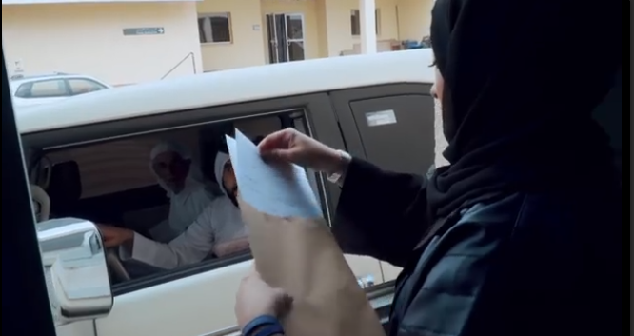
Another Successful Stories….2017
Afkari System from MBRCGI, Total 750 ideas, 140 short listed, 30 selected, 10 funded & 3 won.
Third prize / Afkari Fund Initiative in the Diabetic Foot clinic project
https://www.youtube.com/watch?v=zpKD1IblCdk#action=share
Happiness Window": An outside window in the center for clearance of transactions of the elderly and special needs
https://www.youtube.com/watch?v=CripkdUy11k#action=share

Slide 24
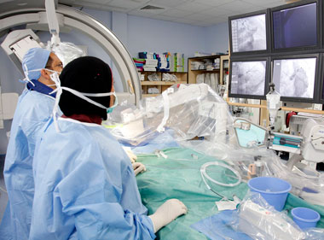
Another Successful Stories….2018
Smart Robotic Surgery in Al Qassimi Hospital
Smart Robotic Pharmacy in Fujairah Hospital

Slide 25
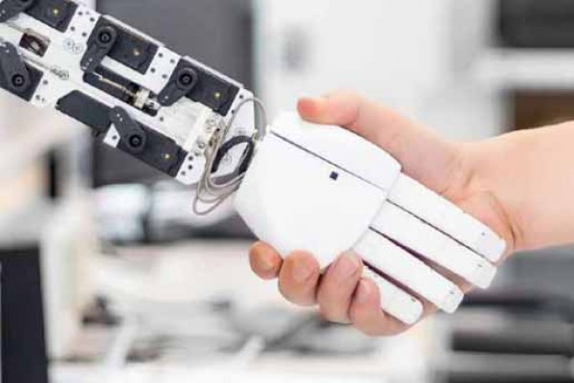
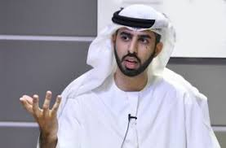
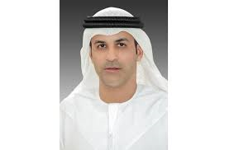
Smart Physiotherapy Rehabilitation Initiative
Games developed specially for rehabilitation in physiotherapy for patients of stroke, cerebral palsy and similar conditions, as it rolls out use of artificial intelligence (AI) and virtual reality (VR) in hospitals. The AI system is already in use in Ras Al Khaimah Physiotherapy and Sports Centre.

Slide 26
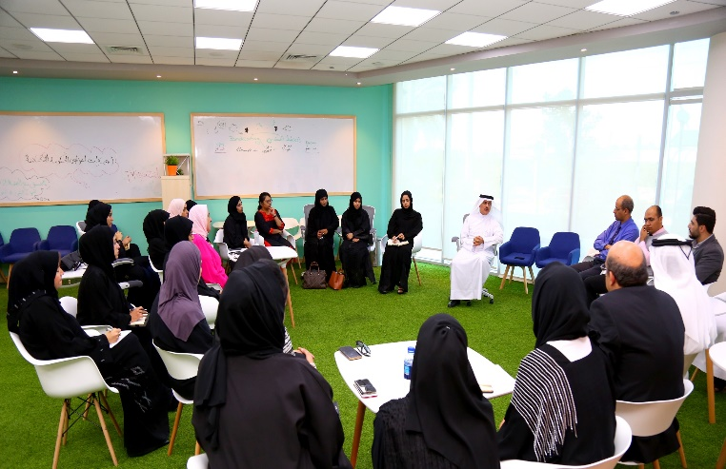
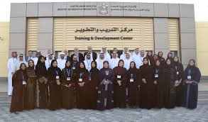
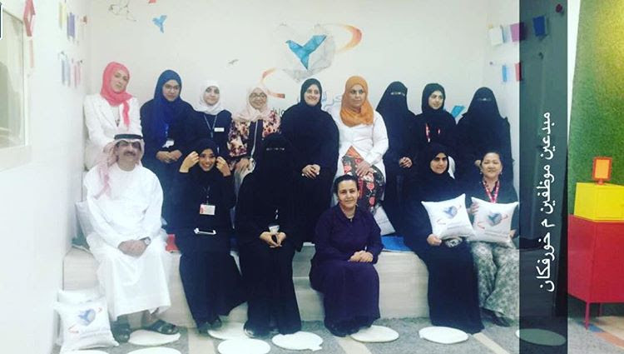
Station 5: Photo Gallery. ..Creating a Culture
5 Permeant Innovation Labs (Hubs) across UAE
@ MOHAP –Dubai
@TDC–Sharjah
@ Khorfakkan Hospital –Sharjah
@ Al Qassimi Hospital
@ Al Dhaid Hospital

Slide 27
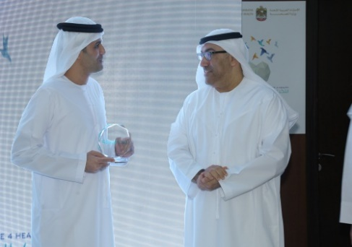
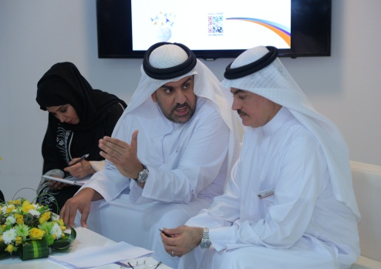
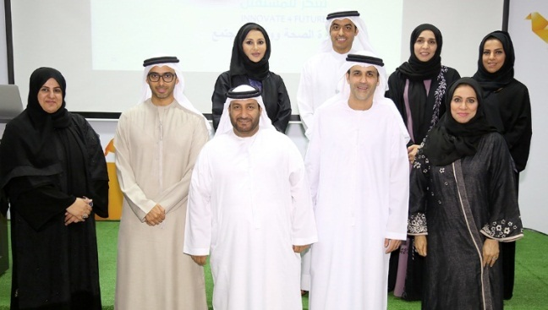
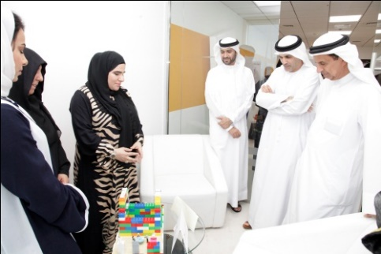
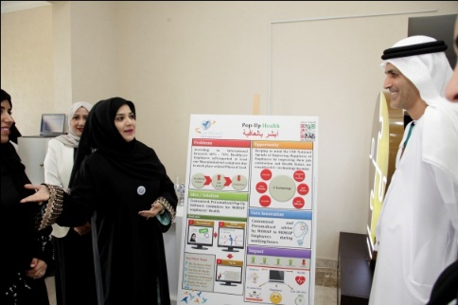
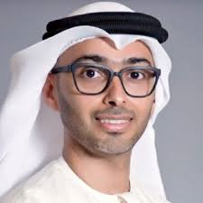
Creating a Culture…Leadership Support & Engagement
Chief Innovation Officer - MOhap

Slide 28
Station 5: Re-Cap & some Thoughts
Station1
To be aligned with UAE 2021
Station 2
To build sustainable Innovation Culture
Station 3
Initiatives @ Care delivery, Building Capabilities & More
Station 4
Platforms & AI
Station 5
Leadership Support
Station 6
What is Next…

Slide 29
And the Journey…continues to Brand Our Services & Attract candidates @ MOHAP in more Innovative Way….
Lightening Dubai Frame on World Mental Health Day
Smart App for Attracting Future Nurses

Slide 30
Thanks
Follow : @mohapuae

